Slide 1
Lecture 08 – Classification Models
Prof. André Gustavo Hochuli
gustavo.hochuli@pucpr.br
aghochuli@ppgia.pucpr.br
Notes:
Prof. André Hochuli

Slide 2
Topics
Discussion of Lecture #07
Image Descriptors
Classification Models
K-NN, Logistic Regression, Decision Trees Naïve Bayes, SVM and MLP
Evaluation Metrics
Accuracy, Precision, Recall and F1-Score
Practice
Computer Vision - Prof. André Hochuli
Lecture 08
Notes:
Prof. André Hochuli

Slide 3
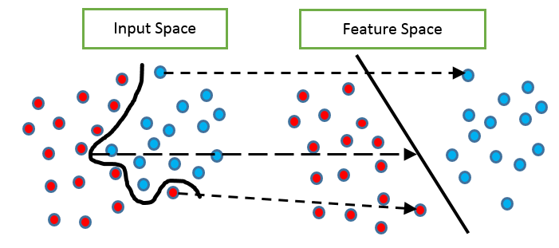
Problem
So far, we extracted features from data to compute the feature space
Computer Vision - Prof. André Hochuli
Lecture 08
Notes:
Prof. André Hochuli

Slide 4
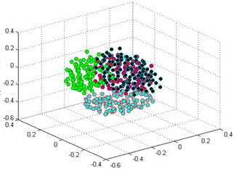
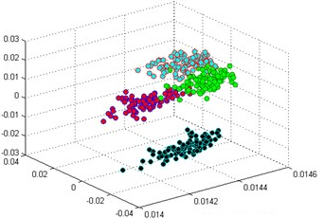
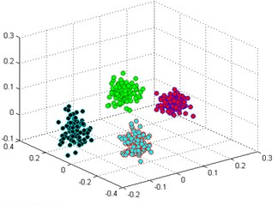
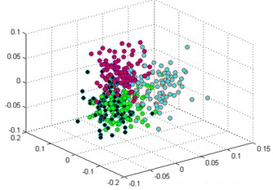
Problem
How discriminative features are?
Input Space
Feature Space’
Feature Space’’
Feature Space ’’’
Computer Vision - Prof. André Hochuli
Lecture 08
Notes:
Prof. André Hochuli

Slide 5
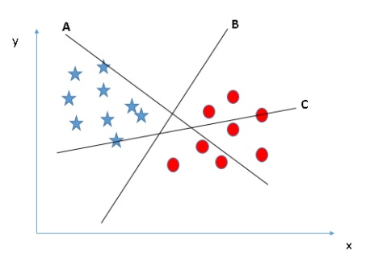
Problem
How to compute the decision boundary?
Computer Vision - Prof. André Hochuli
Lecture 08
Notes:
Prof. André Hochuli

Slide 6
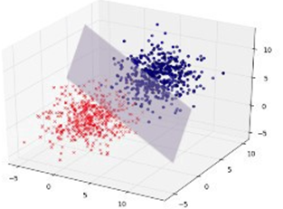
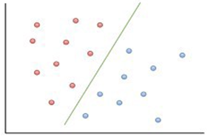
Problem
Hyperplane
2-D, 3-D … N-D (or N-Features)
Computer Vision - Prof. André Hochuli
Lecture 08
Notes:
Prof. André Hochuli

Slide 7
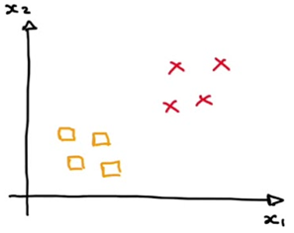
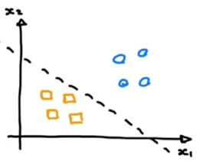
Problem
Binary Classification vs Multi-Class Classification
Computer Vision - Prof. André Hochuli
Lecture 08
Notes:
Prof. André Hochuli

Slide 8
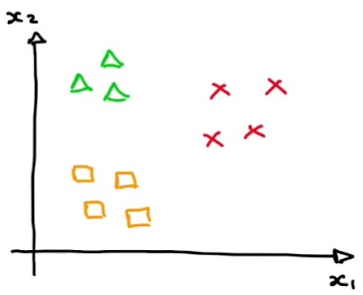
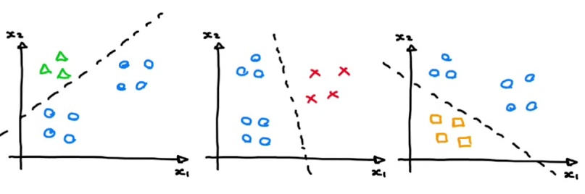
Problem
Binary vs Multi-Class
Computer Vision - Prof. André Hochuli
Lecture 08
Notes:
Prof. André Hochuli

Slide 9
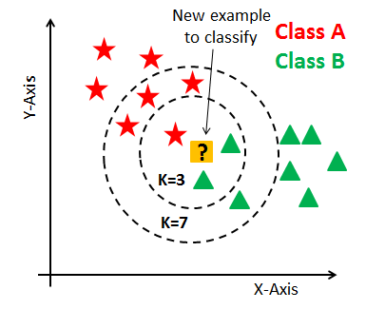
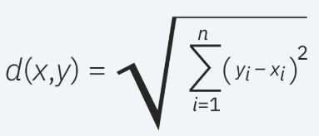
Classification Models
KNN
Computes the similarity in a feature space (Euclidian Distance, Manhattan….)
The K-Nearest Neighbors determines the class (Majority Vote)
There is no training step. Compute the distance of the test sample to each training sample
Computer Vision - Prof. André Hochuli
Lecture 08
Notes:
Prof. André Hochuli

Slide 10
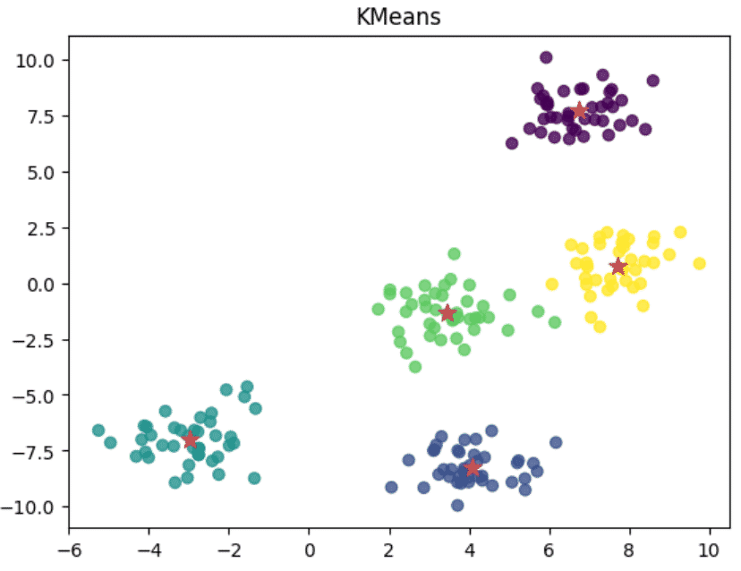
Classification Models
K-Means
Computes the distance between k-cluster
The clusters are defined in training step
Computer Vision - Prof. André Hochuli
Lecture 08
Notes:
Prof. André Hochuli

Slide 11
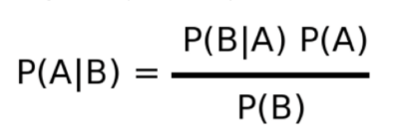
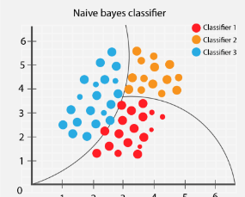

Classification Models
Naïve Bayes
Bayes Theorem
A priori vs Posteriori Probabilities
Computer Vision - Prof. André Hochuli
Lecture 08
Notes:
Prof. André Hochuli

Slide 12
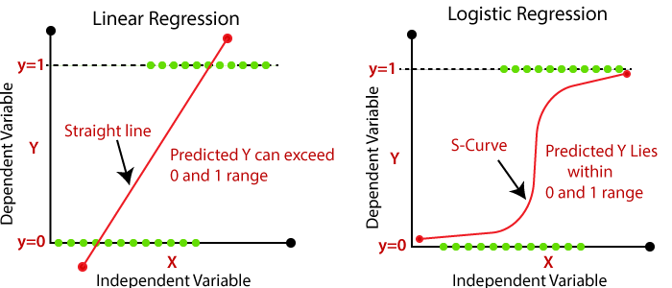
Classification Models
Logistic Regression
Linear vs Logistic
Computer Vision - Prof. André Hochuli
Lecture 08
Notes:
Prof. André Hochuli

Slide 13
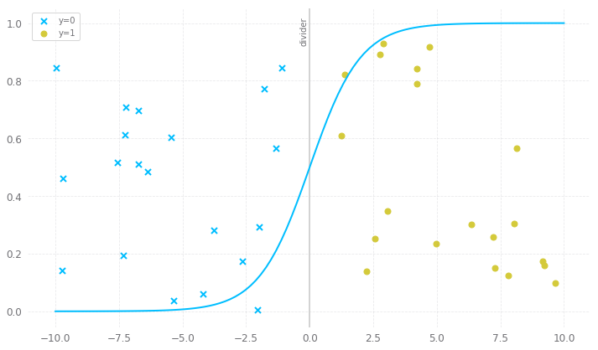
Classification Models
Logistic Regression (LR)
Logistic Boundary
Computer Vision - Prof. André Hochuli
Lecture 08
Notes:
Prof. André Hochuli

Slide 14
Classification Models
Logistic Regression (LR)
Logistic Boundary
Computer Vision - Prof. André Hochuli
Lecture 08
Notes:
Prof. André Hochuli

Slide 15
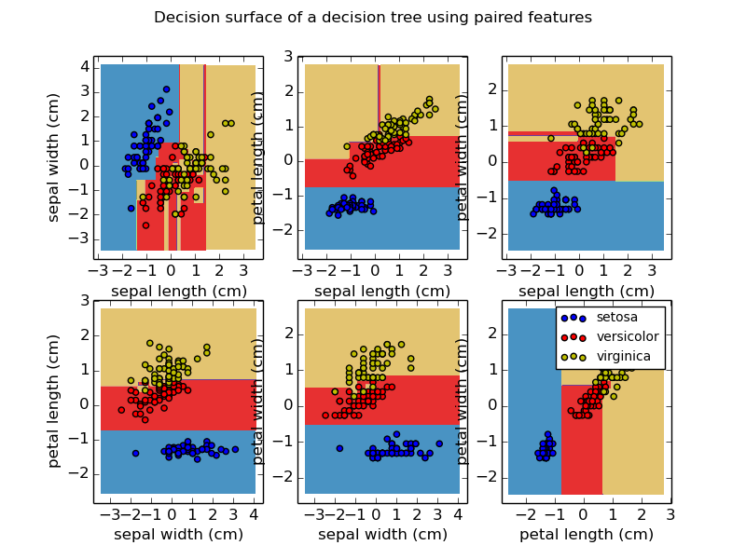
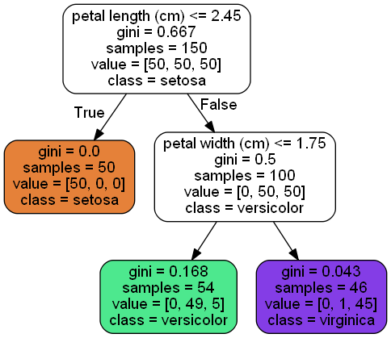
Classification Models
Decision Tree
Creates decision rules direct from the data features
Computer Vision - Prof. André Hochuli
Lecture 08
Notes:
Prof. André Hochuli

Slide 16
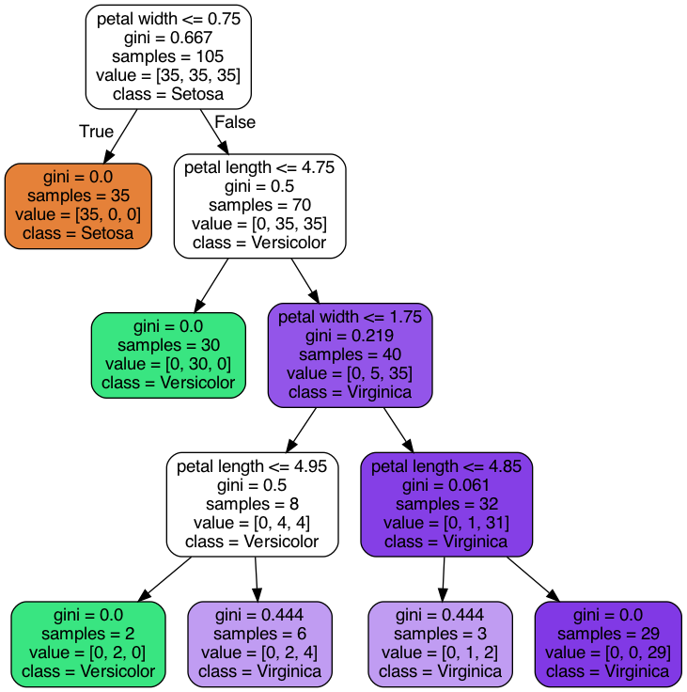
Classification Models
Decision Tree
Computer Vision - Prof. André Hochuli
Lecture 08
Notes:
Prof. André Hochuli

Slide 17
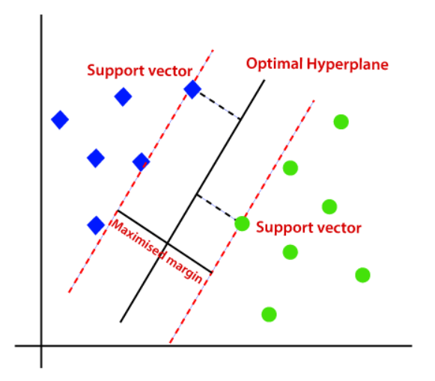
Classification Models
Support Vector Machine (SVM)
Compute Kernel: Linear, RBF, Poly or Sigmoid
The clusters are defined in training step
Computer Vision - Prof. André Hochuli
Lecture 08
Notes:
Prof. André Hochuli

Slide 18
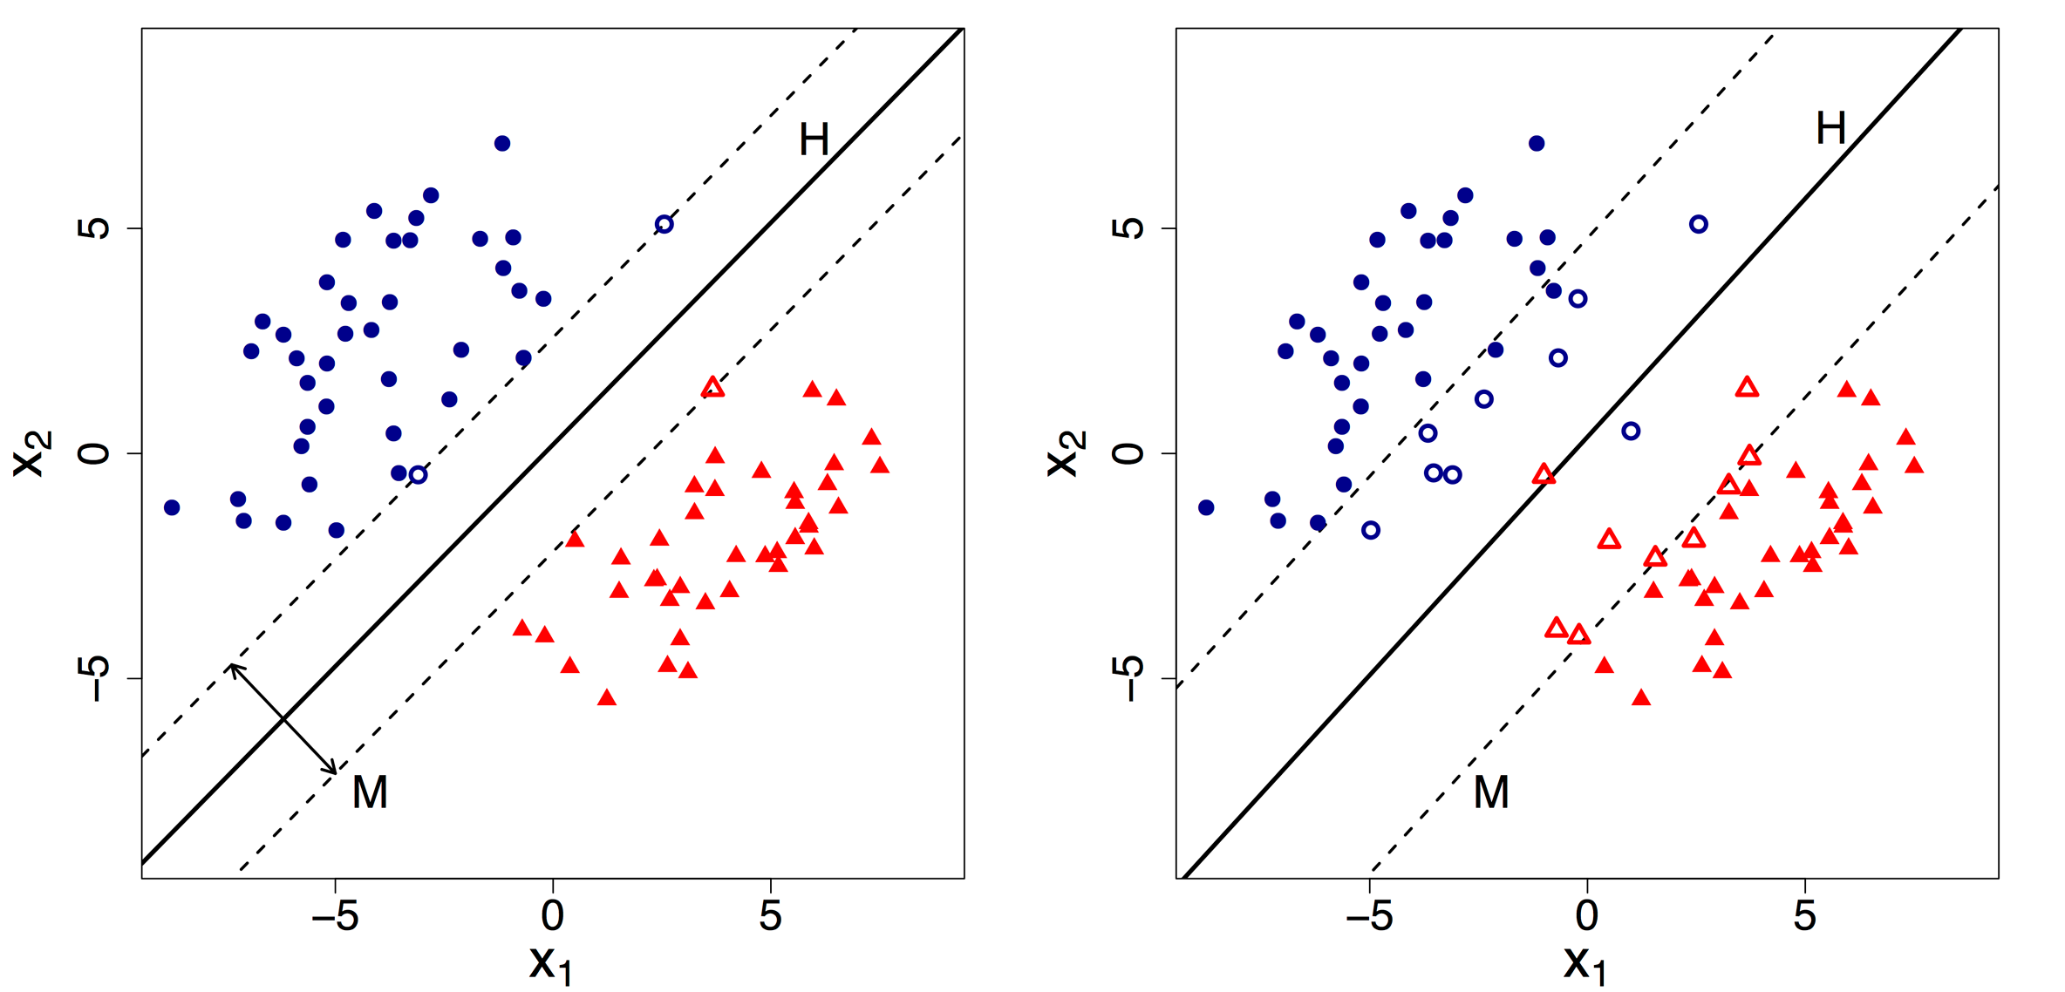
Classification Models
Support Vector Machine (SVM)
Hard Margin
Soft Margin
Computer Vision - Prof. André Hochuli
Lecture 08
Notes:
Prof. André Hochuli

Slide 19
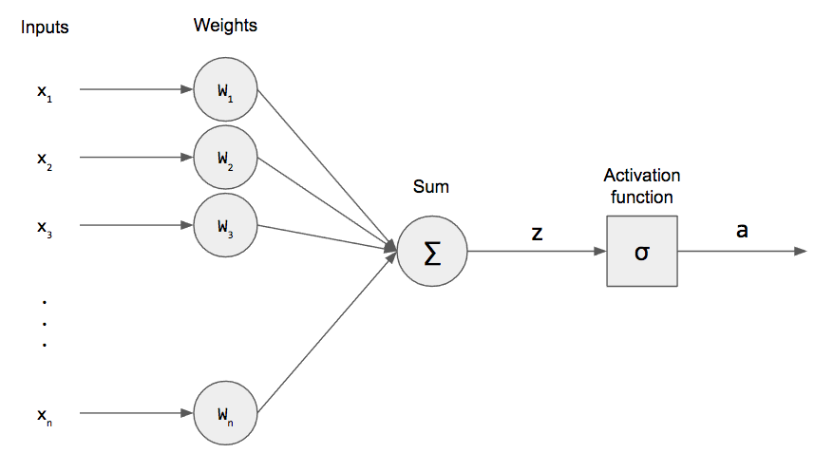
Classification Models
Multi-Layer Perceptron
Perceptron
Computer Vision - Prof. André Hochuli
Lecture 08
Notes:
Prof. André Hochuli

Slide 20
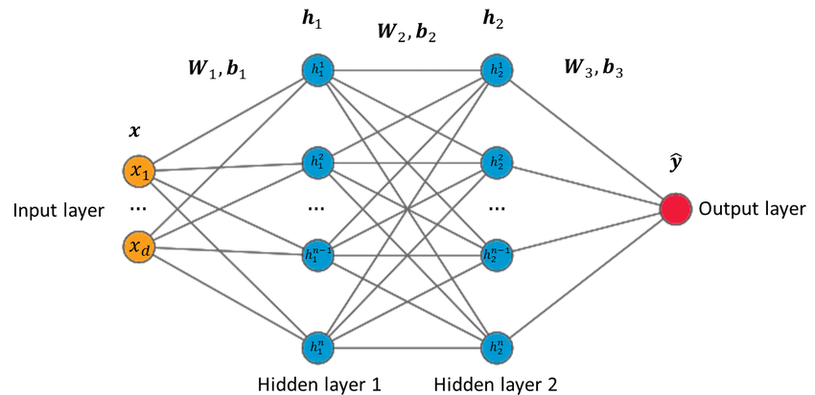
Classification Models
Multi-Layer Perceptron
Multi-Layer Perceptron (MLP)
Computer Vision - Prof. André Hochuli
Lecture 08
Notes:
Prof. André Hochuli

Slide 21
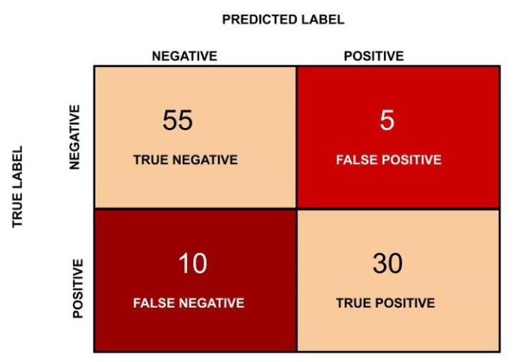
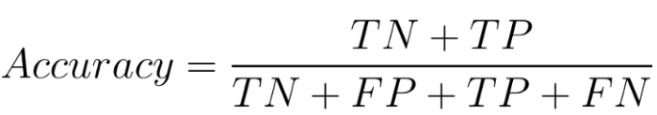
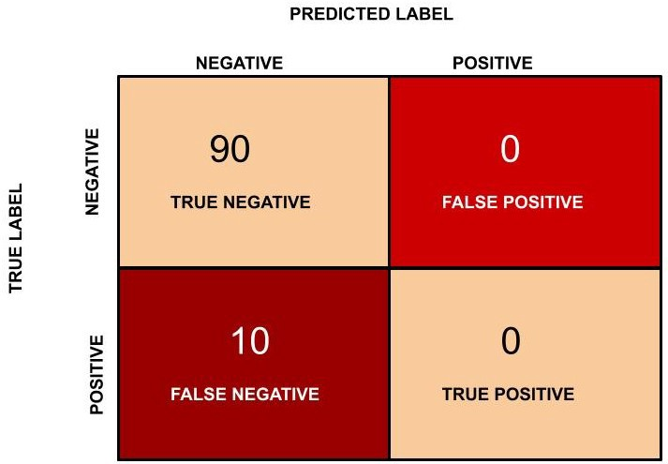
Evaluation Metrics
Accuracy:
Correctly classified instances over total instances
(55 + 30)/(55 + 5 + 30 + 10 ) = 0.85
What is the problem with accuracy?
Imbalanced Data
Acc: 90% (90/100)
Error TP: 100% (10/10)
Computer Vision - Prof. André Hochuli
Lecture 08
Notes:
Prof. André Hochuli

Slide 22
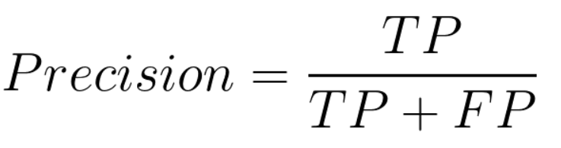
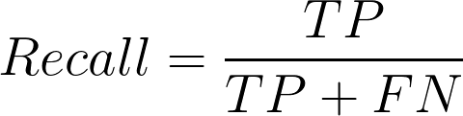
Evaluation Metrics
Precision:
Correctly positive classified instances over
positive predictions
30/(30+ 5) = 0.857
Recall
Correctly positive classified instances over
positive instances (A.K.A Sensitivity or TP Rate)
30/(30+ 10) = 0.75
Computer Vision - Prof. André Hochuli
Lecture 08
Notes:
Prof. André Hochuli

Slide 23
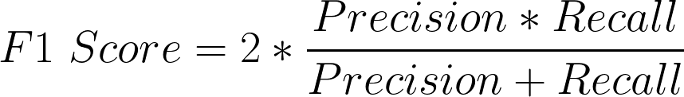
Evaluation Metrics
A good classifier has high Precision and Recall rates.
F1-Score:
Harmonic mean^{(*)} of precision and recall
2* ( 0.857 * 0.75)/(0.857 + 0.75) = 0.799
Final Remarks
Accuracy : 0.850
F1 - Score : 0.799
Precision: 0.857
Recall: 0.750
^{(*)} Harmonic mean gives less weightage to the large values and large weightage to the small values to balance the values correctly. In general, the harmonic mean is used when there is a necessity to give greater weight to the smaller items
Computer Vision - Prof. André Hochuli
Lecture 08
Notes:
Prof. André Hochuli

